Slide 1
Macro-, meso- e microplastiche: dalla detection alla valorizzazione
Mariacristina Cocca, Maria Emanuela Errico
Istituto per i Polimeri, Compositi e Biomateriali
Consiglio Nazionale delle Ricerche

Slide 2
IPCB in SIRIMAP Project
OR6 - Experimental development and demonstrators
Att. 6.4 Realization of prototypes obtained from recycled plastic
The SIRIMAP project aims to develop new remote and proximity detection systems to monitor marine pollution due to macro, meso and microplastics, methodologies for their in-situ and at lab scale analyses, and appropriate strategies for recovery and recycling.
OR3 - Sampling and analysis in situ:
Att. 3.1.a Characterization and
measurement of fibrous microplastics
OR5 - Design of recovery/recycling strategies
Att. 5.4 Preparation of low environmental impact materials
OR4 - Characterization at lab-
scale of meso and microplastics
Att. 4.2 Quantification by Electronic Scanning Microscopy
Att. 4.3 Quantification by thermal analysis

Slide 3
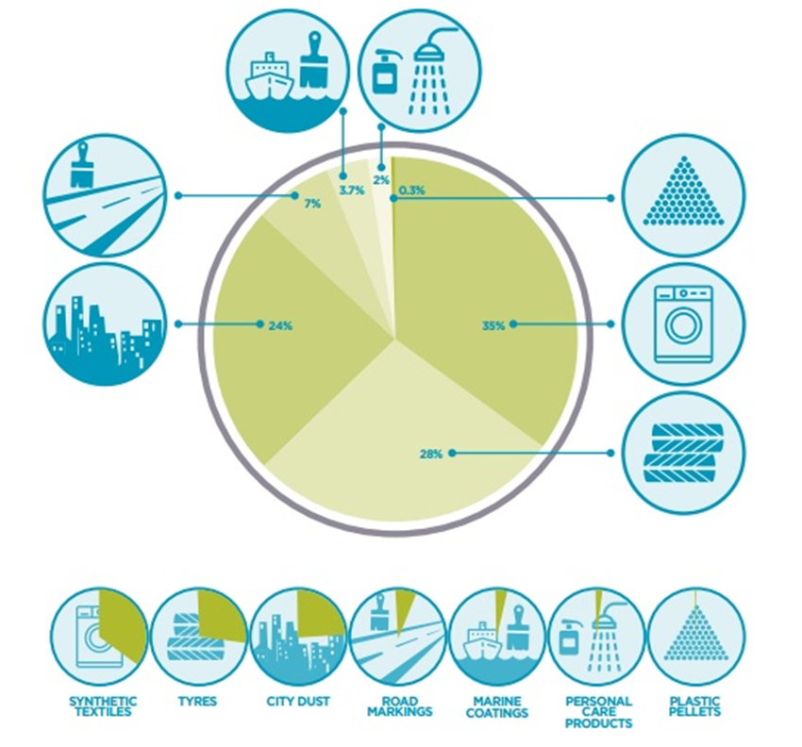
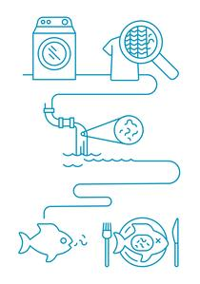
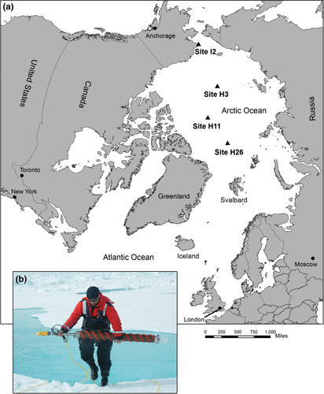
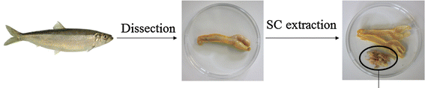
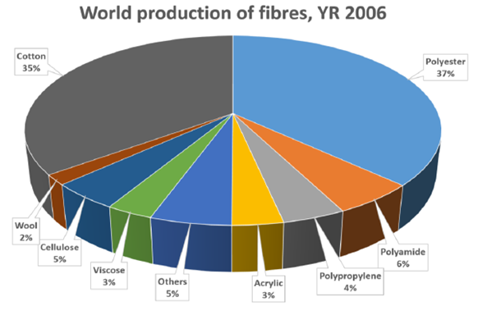
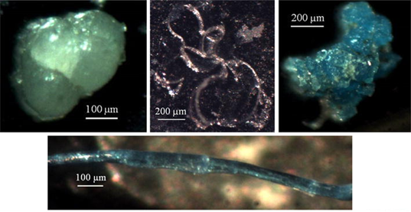
Microplastic Pollution
Polar glaciers
Obbard R et al 2014 Earth's Future 2:315–320
Boucher J. and Friot D. 2017 Primary Microplastics in the Oceans: IUCN.
Fish’s stomach
Microfibers path
Collard F. et al 2015 Arch Environ Contam Toxicol 69:331–339

Slide 4
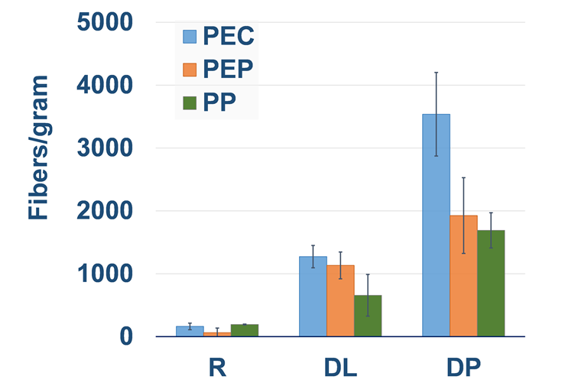
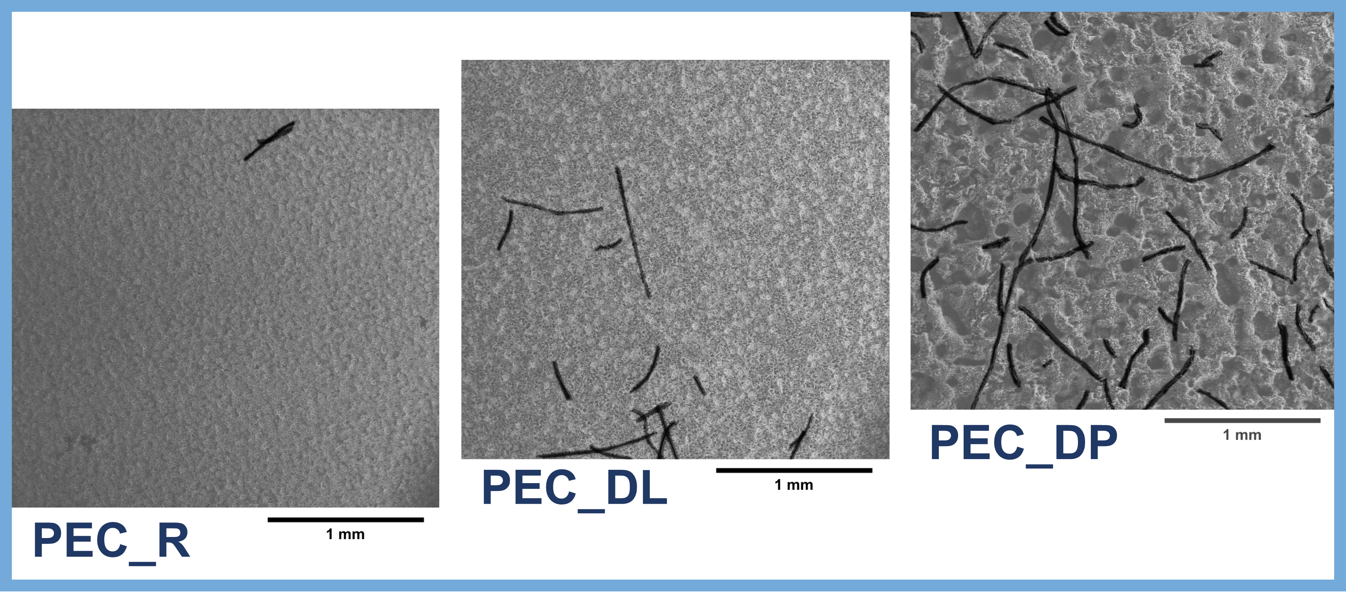
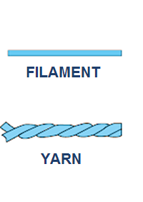

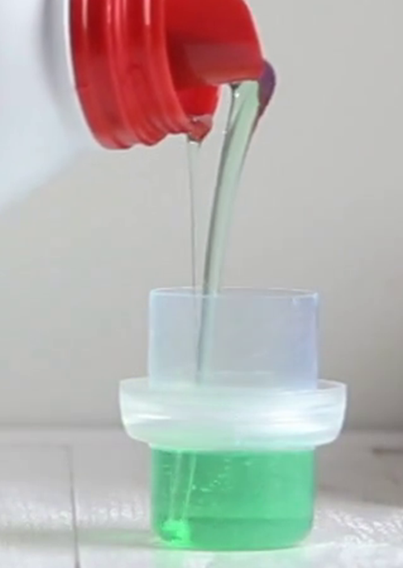
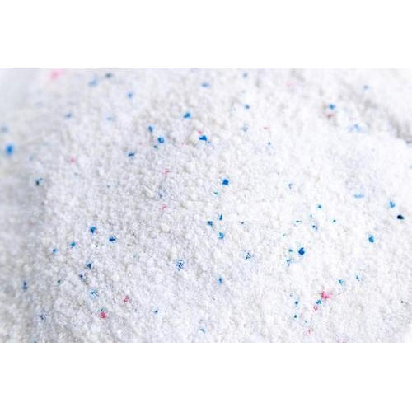
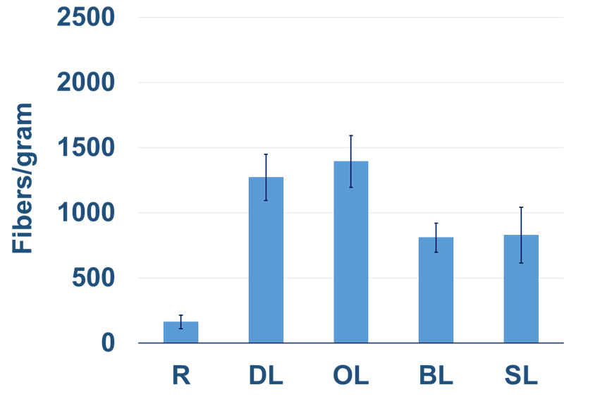
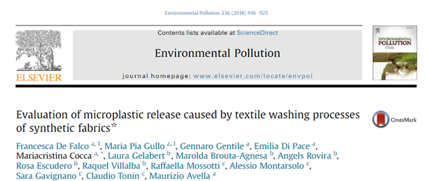
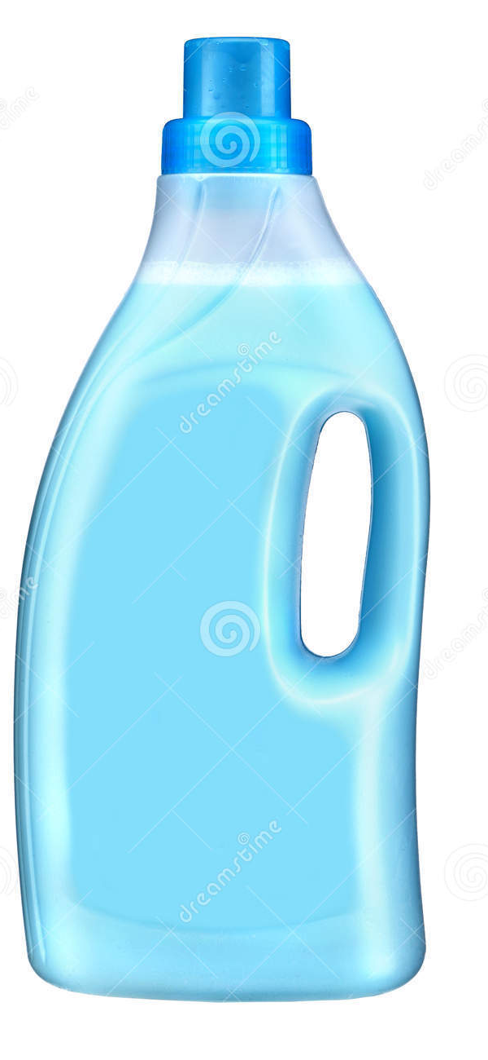






What affects the release of microfibers from fabrics?
Effect of detergent
Effect of yarn type
<
<
>
$$\sim \frac{100 microfibers}{g washed fabrics}$$
$$\sim \frac{1000 microfibers}{g washed fabrics}$$
$$\sim \frac{3000 microfibers}{g washed fabrics}$$
Effect of washing additives
Effect of washing parameters
<
<
Higher temperature washing time and mechanical action produced an increase of microplastics release.
Decrease of more than 35 % the amount of released microfibers

Slide 5
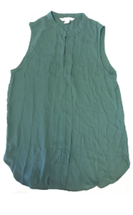
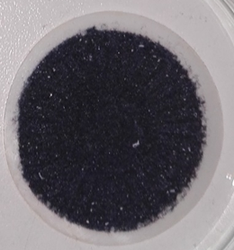
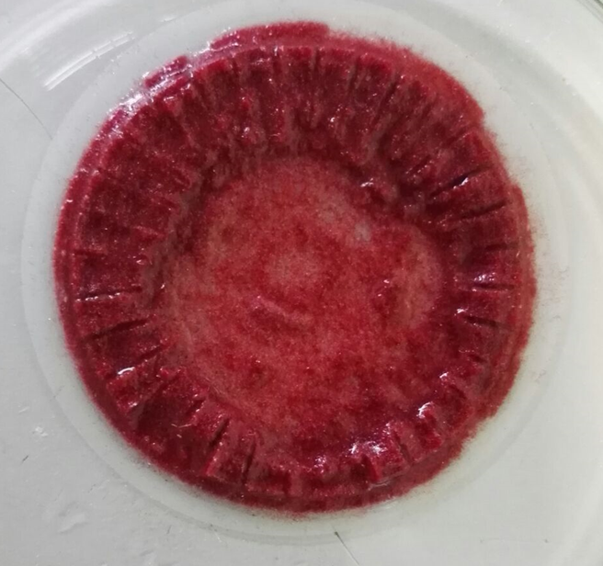
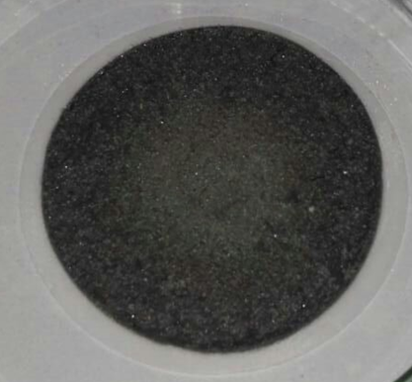
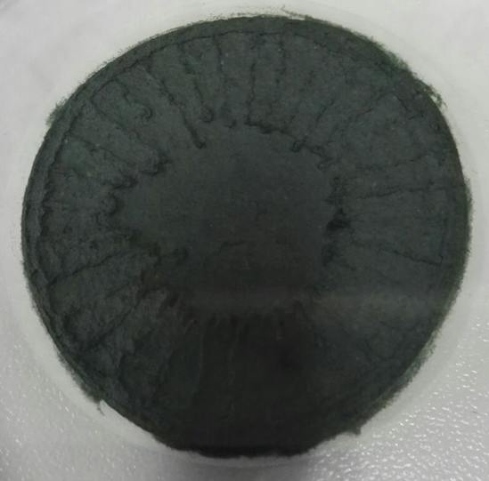





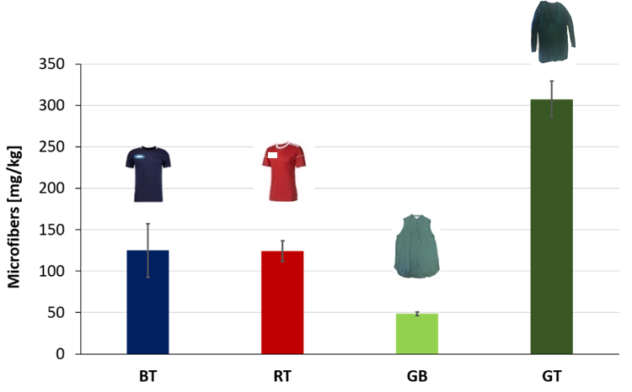
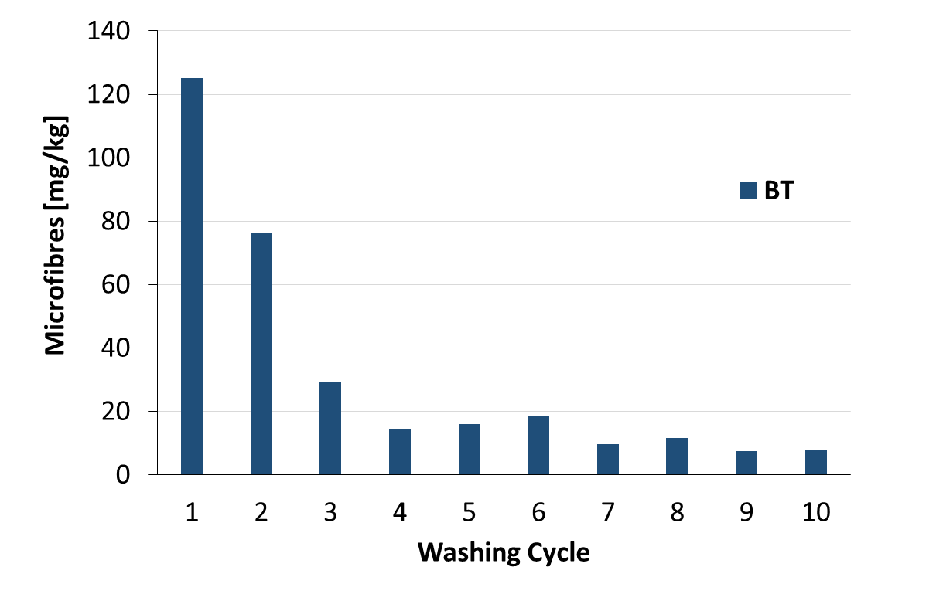
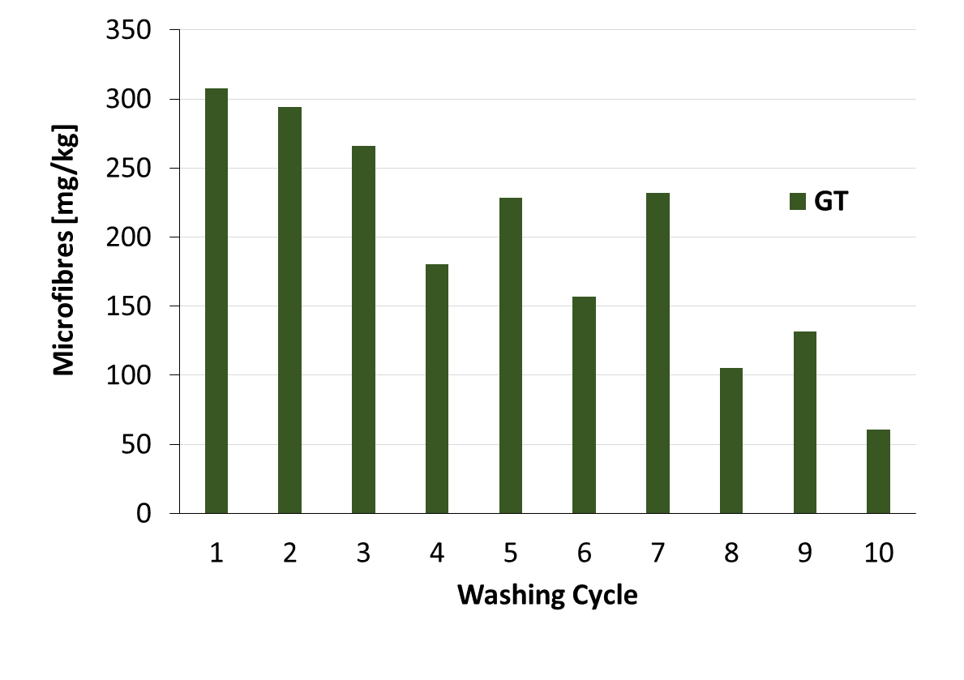
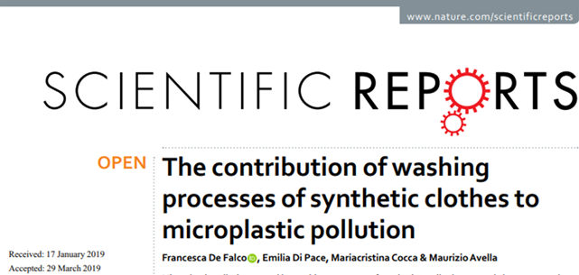
Microplastic release in wastewater: study of garments
Microfibers recovered on filters
T-shirts 100% polyester.
Polyester green blouse
Green T-shirt
Front is made of 100% woven polyester
Back is made of knitted 50% cotton 50% polyester
> 80% are cotton/viscose microfibers
Multistep filtration of the wastewater
Microfibers release during 10 washings

Slide 6
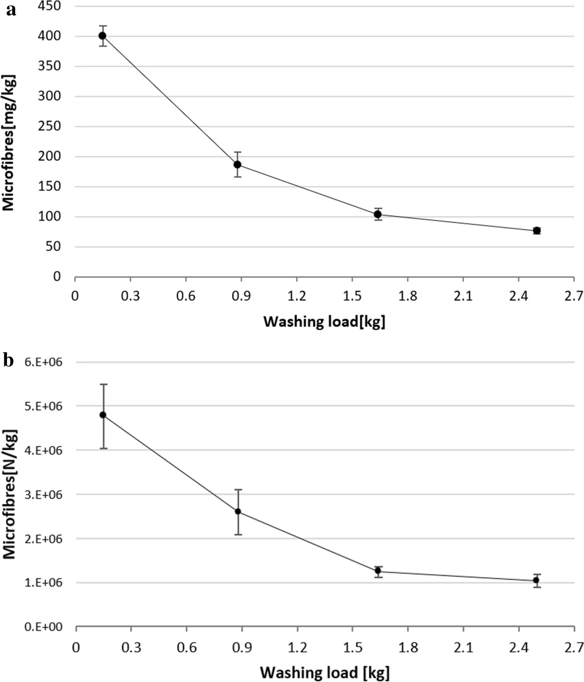
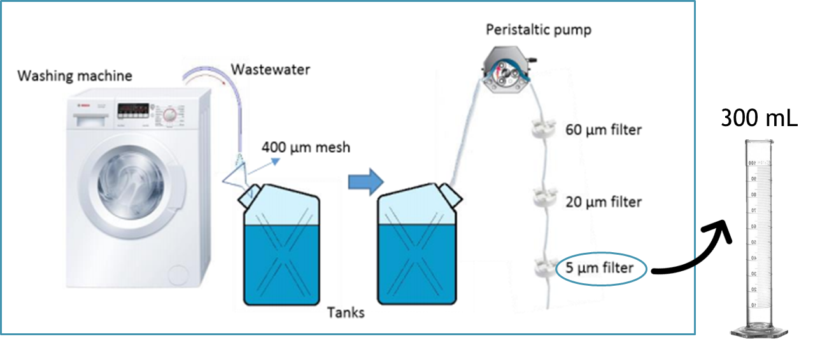
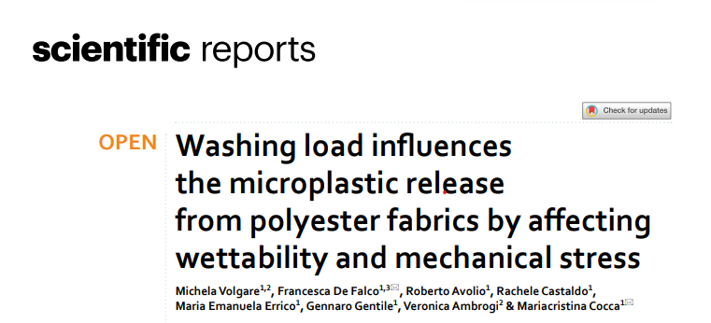
Washing load influences the microplastic release
T-shirts 100% polyester.
The relationship between microfibre release and washing load was assesed to clarify the role of the washing load on the release, through demonstrating two main hypotheses: (1) washing load has an effect on microfibre release, (2) the washing load hides/amplifies the effect of other parameters on the release.

Slide 7
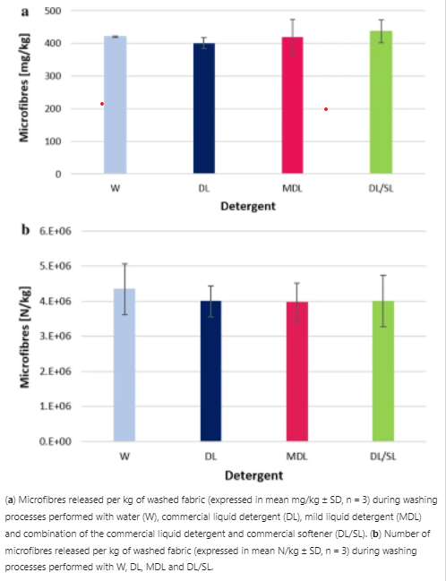
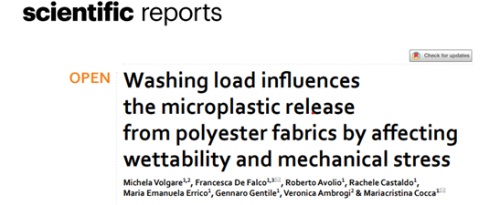
Washing load influences the microplastic release
Washing tests carried out with a single garment led to a greater wettability of the fabric that could enhance the mobility of microfibres that detach from the yarn. The greater wettability is also ascribable to the large water-volume to fabric ratio used in the washing processes of a single T-shirt, e.g. 40 l for a load of 0.15 kg, which is higher than the 50 l used for the 2.5 kg load.
Low washing load hides the effect of the usage of different detergents and different laundry additives on the release since using a low washing load, detergents and additives were not a main factor in microfibres release. The influence of the washing load should be considered to estimate the extent of microfibres pollution in the environment and to account for the high variability of the data reported in literature.

Slide 8
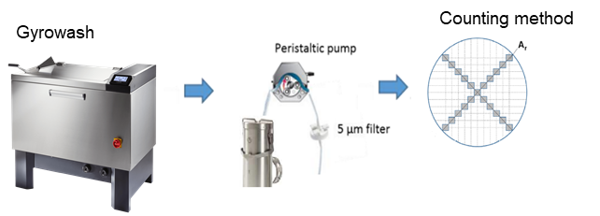
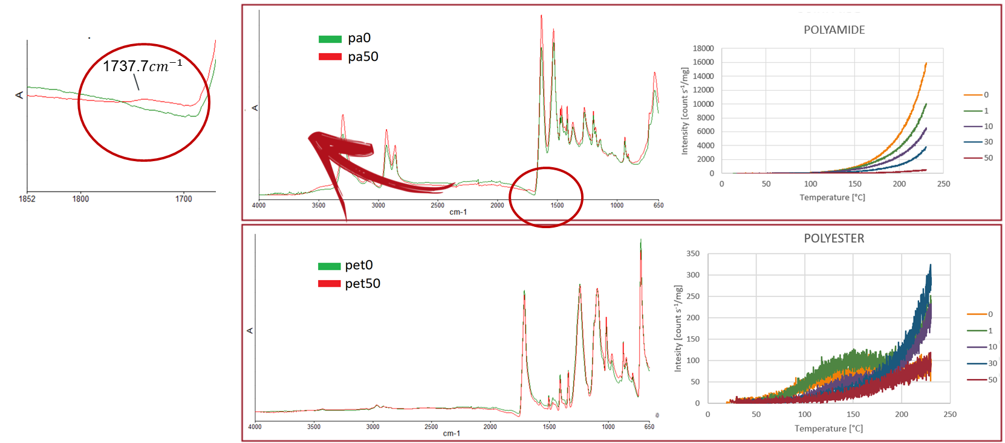
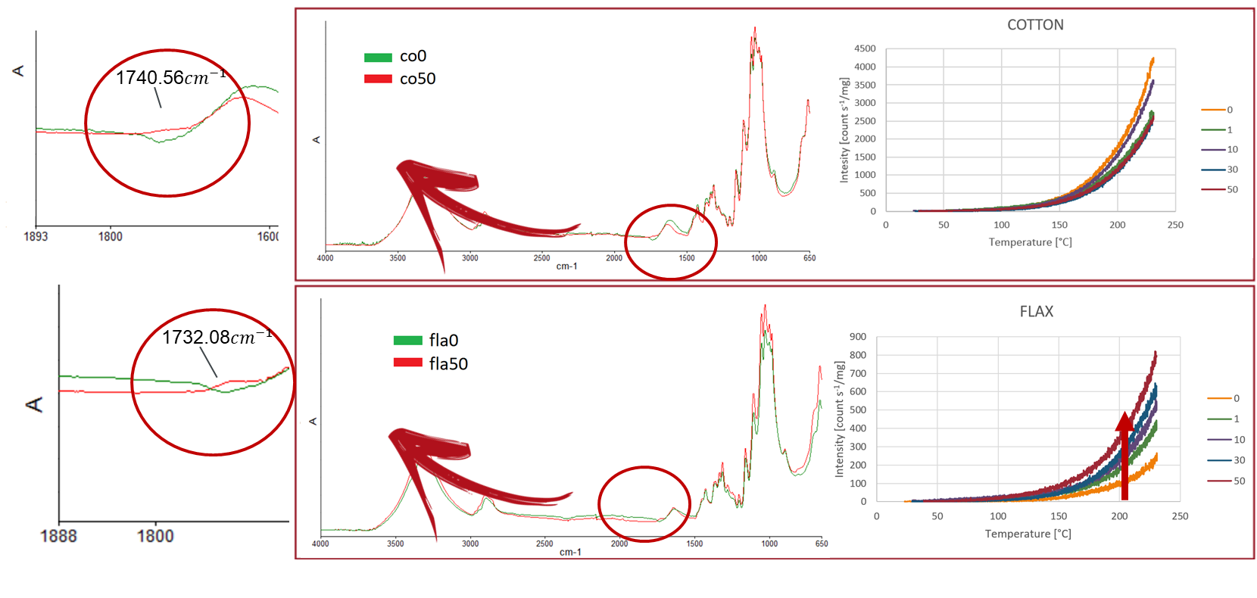
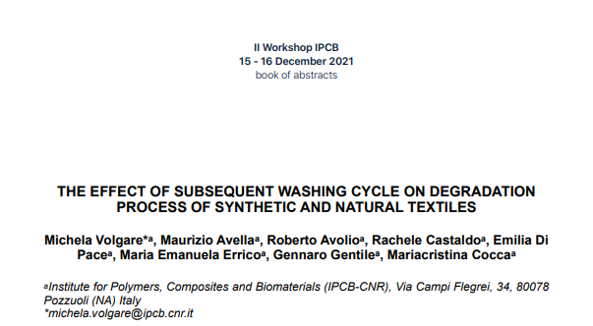
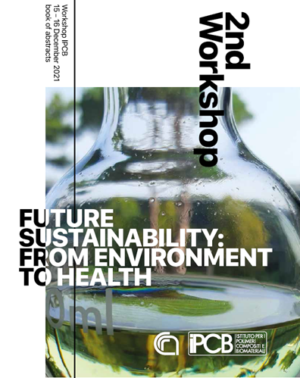
Chemiluminesce and FT-IR Spettroscopy techniques
Effect of subsequent washing cycle on degradation process of textile
1, 10, 30 and 50 consecutive washing cycles were performed on polyester (PET), polyamide (PA), cotton (CO) and flax (FLA)

Slide 9
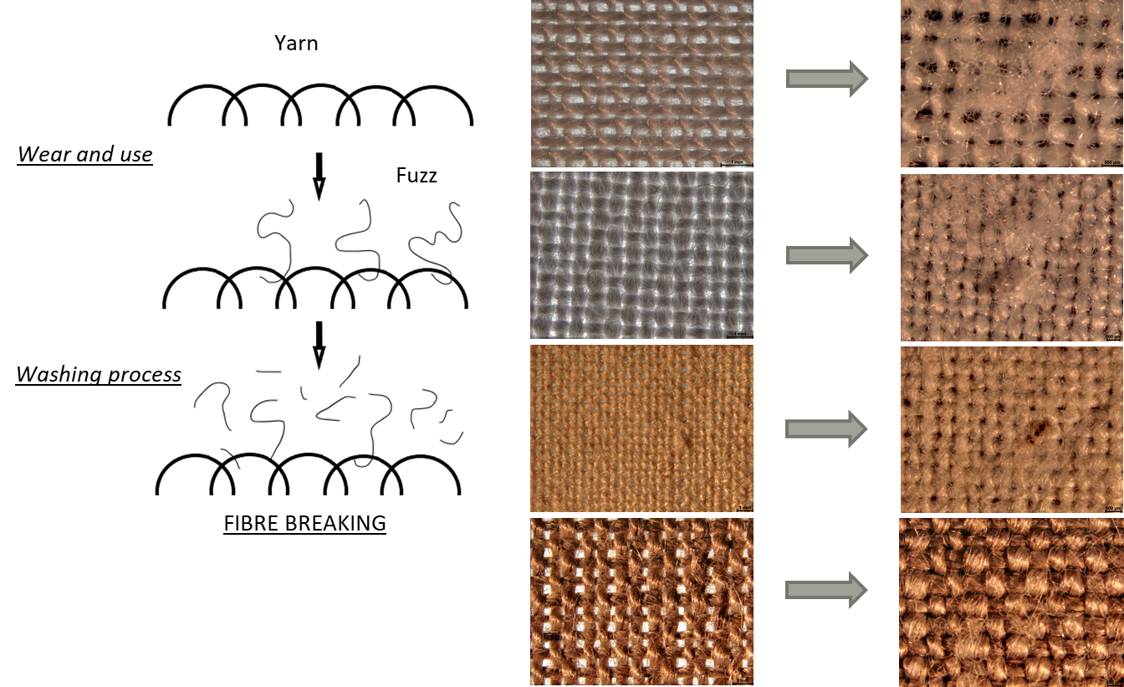
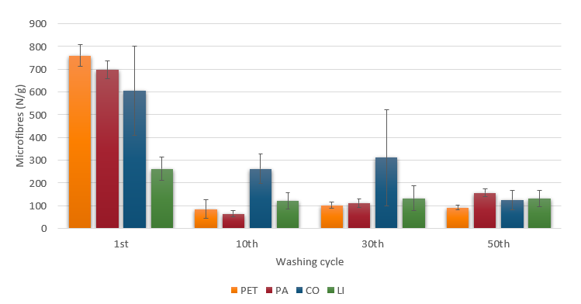
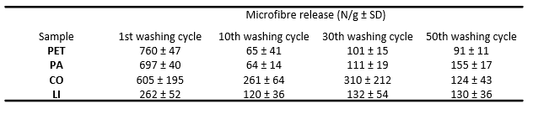
Effect of subsequent washing cycle on degradation process of textile

Slide 10
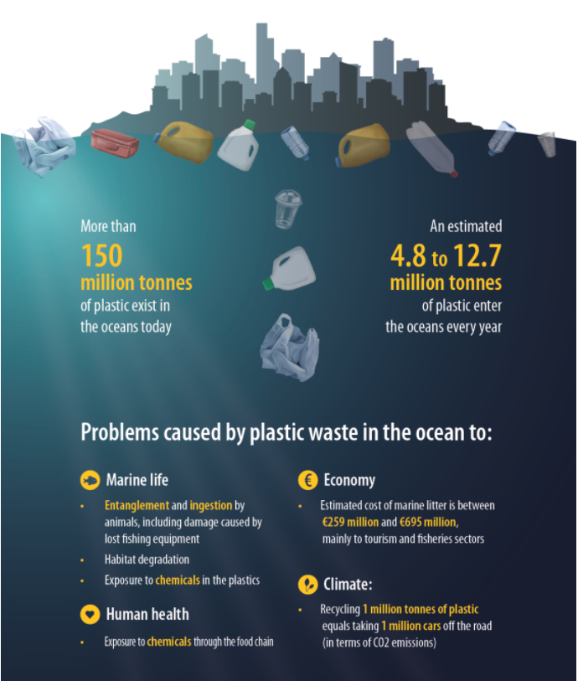

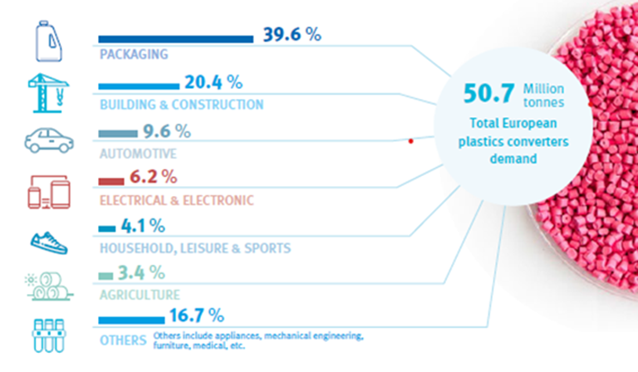
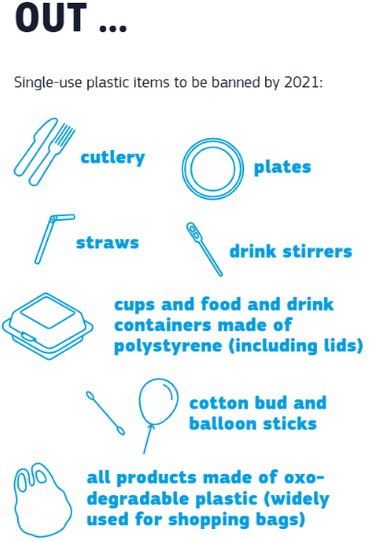
Plastic & Environment
The Single-Use Plastics Directive — Directive (EU) 2019/904 of the European Parliament and of the Council of 5 June 2019
European plastics converters demand by segment in 2019 [PlasticsEurope, Plastics – the Facts 2020]
Notes:
Plastics, due to their ease of manufacture, low cost, mouldable permeability, and their resistance to chemicals, temperature and light, are used in a wide range of products and have replaced and displaced many other materials, such as wood, paper, stone, leather, metal, glass and ceramic. The distribution of European (EU28+NO/CH) plastics converters demand by segment in 2019, reported in Figure 1 shows that packaging represents the largest end-use markets. On a global scale, the packaging industry is an enormous economic generator. Statistics from the well-recognized Smithers Pira organization indicate demand for the world packaging industry will reach $1.05 trillion by 2024. Plastic packaging and single use plastics being versatile materials, are adopted for ensuring the safe delivery of a product (food or non-food) to the consumer at the right time and at the optimum cost. Mostly plastics used in packaging of beverages, fresh meats, fruits and vegetables are under concern today. Single-use packaging results in generation of several billion tons of garbage till date, which pollutes the environment3. The demand for packaging has been increased during COVID-19 pandemic in 2020 from different end-user sectors, as consequence of the increased e-commerce and home delivering for better safety for the food/non food products. In addition, plastic materials for delivery of both food and non-food product are used in large quantities also in humanitarian efforts. In addition, plastic materials for delivery of both food and non-food product are used in large quantities also in humanitarian efforts, e.g. plastic relief items, construction plastics, medical and pharmaceutical plastics, agro-plastics, in IT, telecom and electric equipment, etc. Most of these packaging ultimately end up as waste since in many countries where humanitarian action takes place, sustainable waste management plants rarely exist. When not disposed appropriately, plastic pollution becomes a serious environmental problem According to the report “Out of the Plastic Trap: Saving the Mediterranean from plastic pollution”, published by WWF in June 2018, plastics account for 95% of the waste in the open sea, on the seabed and on beaches across the Mediterranean.
The report states that the Mediterranean basin is home to 150 million people, who produce among the largest quantities of solid urban waste per capita, at 208-760kg per year. The over 200 million tourists visiting the Mediterranean each year generate a 40% increase in marine litter during summer. Every year 150,000-500,000 tonnes of macroplastics and 70,000-130,000 tonnes of microplastics enter European seas. The vast majority of these plastics end up in the Mediterranean.

Slide 11
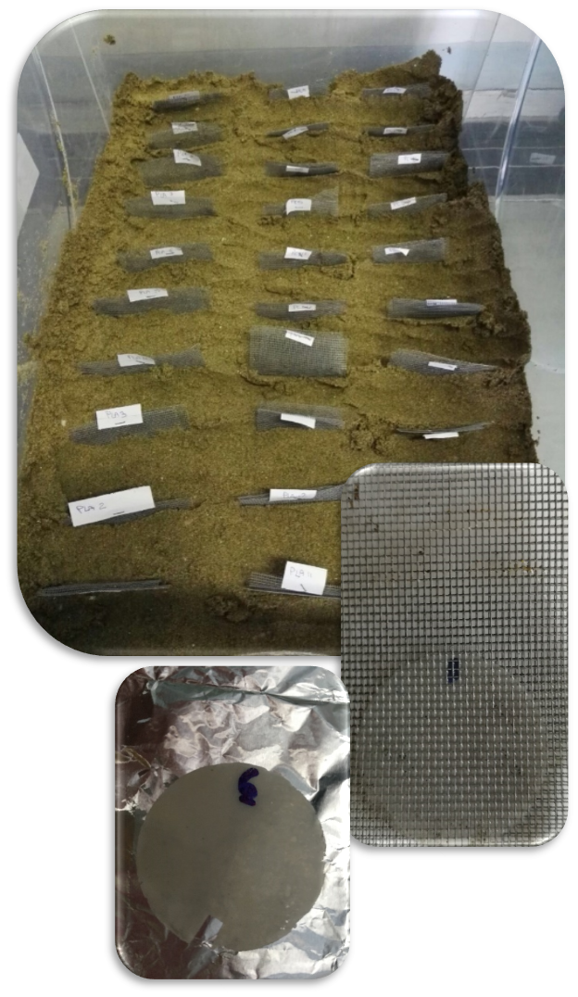
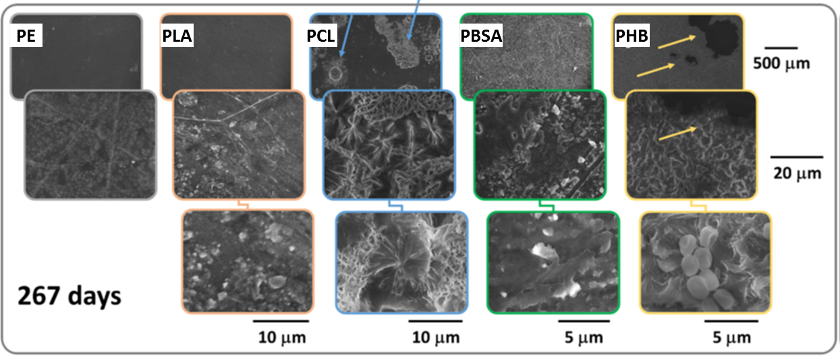
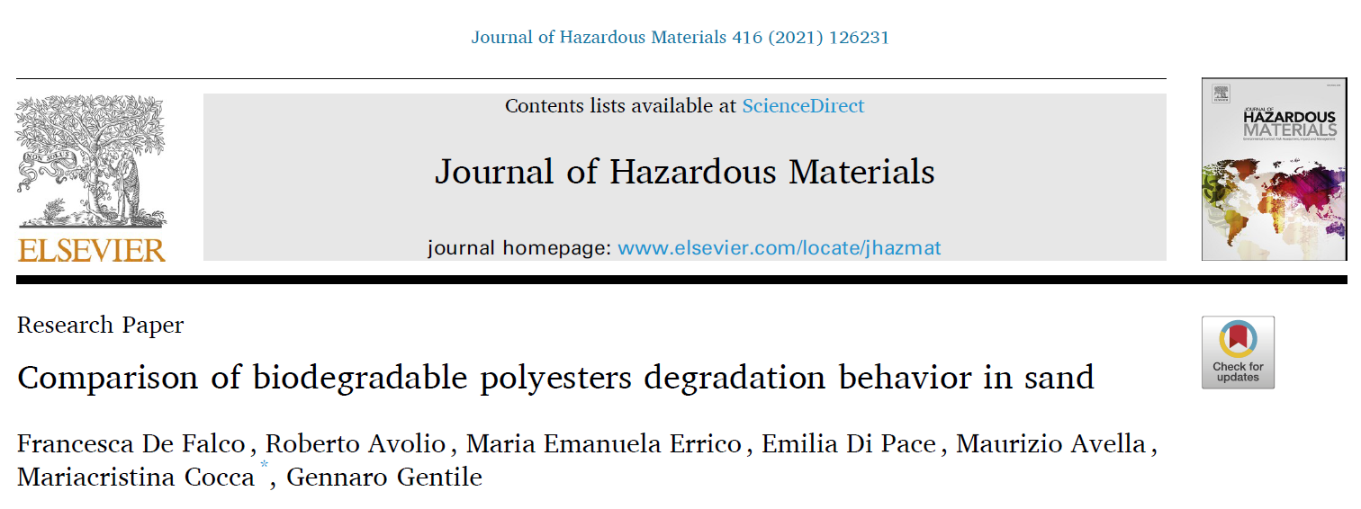
Degradation of biodegradable polyestsers in sand
In order to investigate the degradation of biodegradable polymers in a marine habitat, film specimens of poly lactic acid (PLA), polycaprolactone (PCL), polyhydroxybutyrate (PHB) and polybutylene succinate adipate (PBSA) were buried in sand
The polyesters showed different degradation mechanisms and kinetics.
The degradation trend of the investigated materials in sand decreased in the order PHB > PBSA > PCL > PLA. PLA, PCL and PBSA did not undergo complete degradation in sand during the testing time.
Notes:
The appearance of PCL, PHB and PBSA films underwent significant changes during the degradation test while PLA and PE remained almost
unaltered up to 267 days. The weight of PLA remained almost unchanged during the whole burial period with a weight loss curve close to that obtained for PE. PCL, PBSA and PHB, all showed an initial latency period of about 42 days; in this period the weight loss was lower than 3% for all the systems. After this incubation period, the weight loss started with different rates for PCL, PBSA and PHB. Indeed, the weight loss of PCL increased slowly, reaching about 11% and 13% at 200 and 267 days of sand burial, respectively. A significant decrease in the weight loss of PCL was observed when passing from 116 days to both 200 and 267 days of degradation time. The weight loss of PBSA was faster than that recorded for PCL, reaching about 18% at 200 days of sand burial and then about 45% at 267 days. Finally, PHB showed the fastest degradation, with over 15% weight loss after 56 days, followed by a stable period until about 116 days of sand burial, and then a rapid weight decrease between 116 and 200 days reaching a final loss of about 90%.
After 267 days of sand burial PLA shows slight change in the morphology as PE, PCL films show large, irregular defects with dimensions ranging from about 100 μm up to a few millimeters, evidenced at low magnification by blue arrows. Moreover, at higher magnification, together with grooves and cracks, several spherulites with an average diameter of about 10 μm were observed (better evidenced in the blue inset). PBSA surface results damaged larger and more diffuse surface defects, including cracks and holes, are observed only after 267 days of burial times. The recorded morphologies are comparable to those observed after soil burial tests of PBSA and confirm what already evidenced at the macro scale, i.e. the pronounced embrittlement of the PBSA films during burial that induces the fragmentation of the film (see Fig. 2a) (Avolio et al., 2015a, 2015b). Finally SEM images of PHB shows typical of a pronounced biodegradation of the material. after 267 days of sand burial the PHB film was strongly degraded so that it was impossible to evaluate its weight loss. The SEM analysis of the residual fragments show the presence of large holes, evidenced with yellow arrows Moreover, signs of biological attack are evident on the surface of PHB fragments, as shown in the high magnification inset.

Slide 12
Degradation of biodegradable polyestsers in sand
All polyesters, except PHB, present a similar trend in the crystallinity index X_{c} during burial time: X_{c} remains nearly constant in the first stages of burial and then after longer burial time its value increases. Buried samples presented a lower thermal stability (Td) due to their degradation state.
PLA: no significant changes in the chemical structure.
PCL: a decrease in bands at 1720 cm⁻¹ of the ester groups.
PBSA: decrease of the C=O stretching band at 1713 cm⁻¹ and of the -C-O-C- band at 1164 cm⁻¹ and increase in the OH group, as a result of a progressive hydrolysis of the ester bonds.
PHB: decrease, with burial time, of the C=O stretching band at 1719 cm⁻¹ and an increase of the OH group. The appearance of an absorption peak at 1570 cm⁻¹ could indicate the occurrence of an enzymatic degradation since it could be assigned to the (N-H) bending of amides associated with protein
Notes:
All polyesters, except PHB, present a similar trend in the crystallinity index Xc during burial time as reported in Fig. 3b: their crystallinity index Xc remains nearly constant in the first stages of burial and then after longer burial time its value increases.
PLA show the evidences of physical aging with a progressive increase of Tg and a broadening of the cold crystallization peak as a function of burial time. The area of the endothermic peak associated with relaxation process increases and the peak shifts to higher temperature with the increase of aging time, as a consequence of the lower free volume and enthalpy of the aged samples
Thermal data in agreement with SEM analysis point out that in PCL the amorphous regions are degraded faster, leaving spherulitic structures exposed. This result seems to be in line with the PCL degradation mechanisms hypothesized by Lu et al. (2018), for which the degradation occurs at the sample surface during aging. In detail, during degradation, the aged material is gradually peeled off from the surface, while the inner of the samples remains unaffected (Lu et al. 2018); as a result, the weight loss progresses slowly and the peeling of the surface, combined with the loss of amorphous parts leaves the crystal structures exposed. The increased presence of crystalline structure at the surface may hinder further advancement of the degradation process. Possibly, these crystalline regions are less susceptible to biological attack, and then they could contribute to reduce the degradation rate at high burial times, as indicated by the flattening of the PCL weight loss curve
In the case of PBSA, the Xc increase of more than 4% was obtained after a burial period of 77 days. Such increase could be associated to the degradation of the amorphous regions and microstructural rearrangements in the polymer that induce a rise in crystallinity. Concerning PHB, that showed the fastest and most complete degradation, after 49 days there was a steep reduction of the crystallinity index as a result of the matrix integrity loss and an extended degradation that involved both amorphous and crystalline regions.
These results indicated that buried samples presented a lower thermal stability due to their degradation state. The aging process led to polymer degradation involving the decomposition of polymer chains and the formation of low molecular weight compounds. The low molecular weight compounds have lower thermal stability and should be degraded and/or volatilized more easily, thus lowering the Td values
The spectra of PLA samples did not show, within experimental error, any significant changes in the OH and C˭O absorption bands indicating that no significant changes in the chemical structure of PLA were obtained during 267 days of sand burial, in line with the absence of extensive degradation observed for PLA during this period. CI remains unaltered during aging, only a slight increase in CI was observed at the beginning of the degradation, Fig. 6e. The FTIR spectra of PCL during the burial period, normalized for the bands at 720–730 cm􀀀 1 due to –(CH2)n– stretching vibration, are reported in Fig. 4b (Fukushima et al., 2013). During degradation, a decrease in the IR absorption bands at 1720 cm􀀀 1 of the ester groups is visible, confirming the effective process of degradation of PCL. Notwithstanding this, no evidence of the typical IR absorption of carbonyl groups belonging to carboxylic acids formed by hydrolytic scission of the ester groups on the polymer chains at about 1738 cm􀀀 1 for PCL was observable (Li and McCarthy, 1999). CI rather increased at the beginning of the degradation, Fig. 6e. FTIR spectra of PBSA, normalized in the range 760–700 cm􀀀 1, during burial time are characterized by a progressive decrease of the C˭O stretching band at 1713 cm􀀀 1 and of the -C-O-C- band at 1164 cm􀀀 1 and increase in the OH group stretching vibration, as a result of a progressive hydrolysis of the ester bonds during aging. CI increased during the degradation test, Fig. 6e. The PHB spectra during aging time are characterized by a progressive decrease, with burial time, of the C˭O stretching absorption band at 1719 cm􀀀 1 and an increase of the OH group stretching vibration band in the range 3000–3500 cm􀀀 1. The appearance of an absorption peak at 1570 cm􀀀 1 during degradation, could indicate the occurrence of an enzymatic degradation since it could be assigned to the (N-H) bending of amides associated with protein (Zeroual et al., 1994). As reported in Fig. 6e, CI gradually increased during 77 days of burial as consequence of hydrolytic degradation and than strongly decreased probably as consequence of biological attack (Salazar-S´anchez et al., 2019). No change in the FTIR spectra of PE were detected during burial time indicating that the sample remained unaltered during sand burial

Slide 13
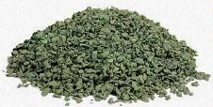
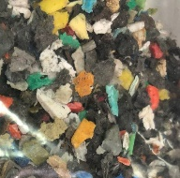
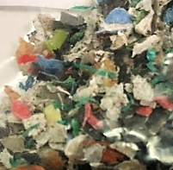
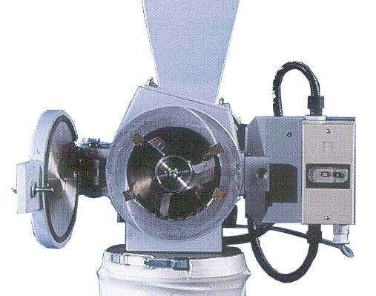
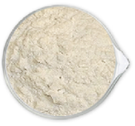
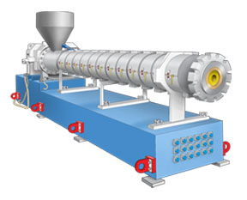
Evaluation of recycling strategies for plastic marine pollutants
Polymers with similar processing conditions (PE, PP) → Milling + melt blending →Composites
Obtainment of polymer blends
Combination with recycled polymers to improve properties
Presence of non-olefinic fragments and contaminants
Recycled polymer matrix
Additives
Polyolefins from marine litter
Milling
Due to the presence of multicomponent products and surface contamination, sorted fractions still contains a variety of secondary polymeric phases
Melt Processing
Main results:
Blending with recycled polymers is a route to optimize properties
PP based blends show increased strength and higher ductility
PE based blends show high deformation (but high variability due to defects)

Slide 14
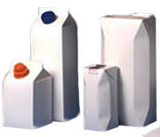
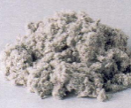


Beverage Cartons Scraps and Recycled Polyethylene
Multicomponent materials with high content of cellulose fractions → Milling + compounding
As a model system for litter with high content of non polymeric materials, a common multilayer packaging (MC) was selected
A recycled HDPE was used to produce composites
Maleated PE (MAPE) was also considered as a process additive
Recycled HDPE
Additives
Model system: multilayer cartons (paper, aluminum, PE)
Milling
High amount of carton scraps in marine litter;
High commercial distribution in place of traditional PET bottles.
Melt Processing

Slide 15






Beverage Cartons Scraps and Recycled Polyethylene
Water absorption increases with increasing MC content
The additive slightly reduces the water uptake
MC + recycled HDPE
Up to 90 wt% MC
MC + recycled HDPE
Composites containing cartons show high stiffness, related to MC content
The additive induces an increase in strength

Slide 16













Prototyping
MC + HDPE 50/50
MC + HDPE 50/50 Laminated with HDPE
PA fishing net + PS 10/90
PA (fishing net) milled at 1mm + PS 50/50
PE-PP (Litter) + recycled PE 40/60

Slide 17


International Conference & Trianing School

Slide 18
GRAZIE

